Slide 1
Satellites to Seeds
National 4-H Geospatial Leadership Team

Slide 2

Meet your speakers
Vrishab Nooka
Vrishab Nooka
Associate Director
Associate Director

Slide 3
Today’s Agenda
01
02
03
04
05
06
AI in education
GIS in Agriculture
Map the Future Farm
Environmental
Risk
Activity: Disaster Strikes
AI Demo: Teachable Machine

Slide 4
01
AI in Education

Slide 5
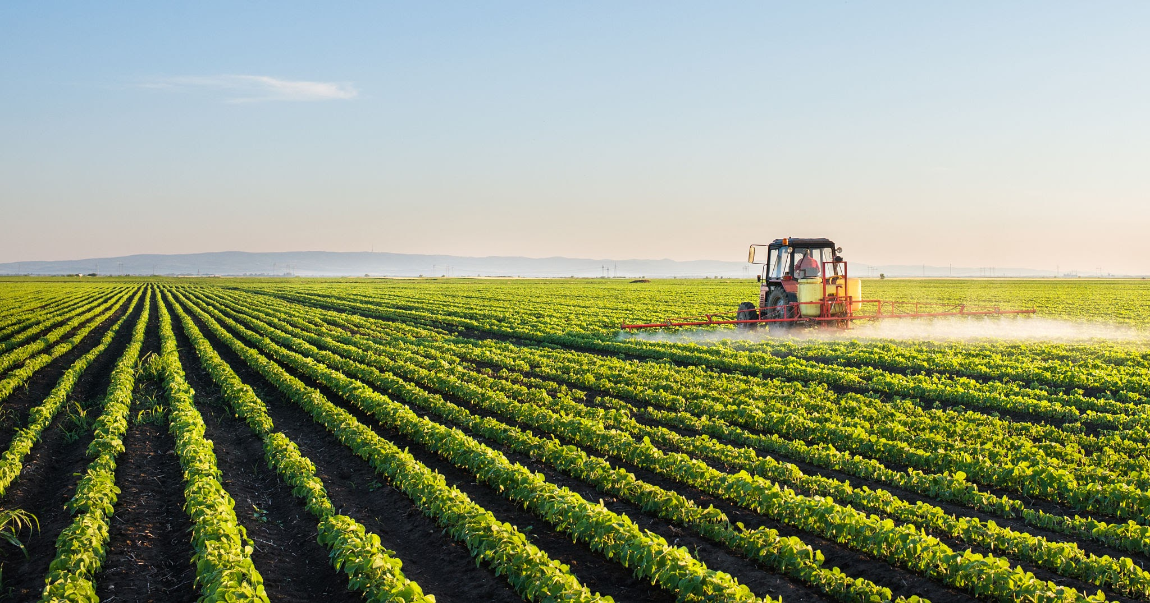
Discuss:
Where does our food come from?

Slide 6
Discussion
What is AI?
How can we use AI in education?
What are good uses vs risks of AI?
Where should we trust AI, where should we not?

Slide 7
Today, we’ll use AI and maps to make smart farming decisions — but you stay in control.

Slide 8
02
GIS in Agriculture

Slide 9
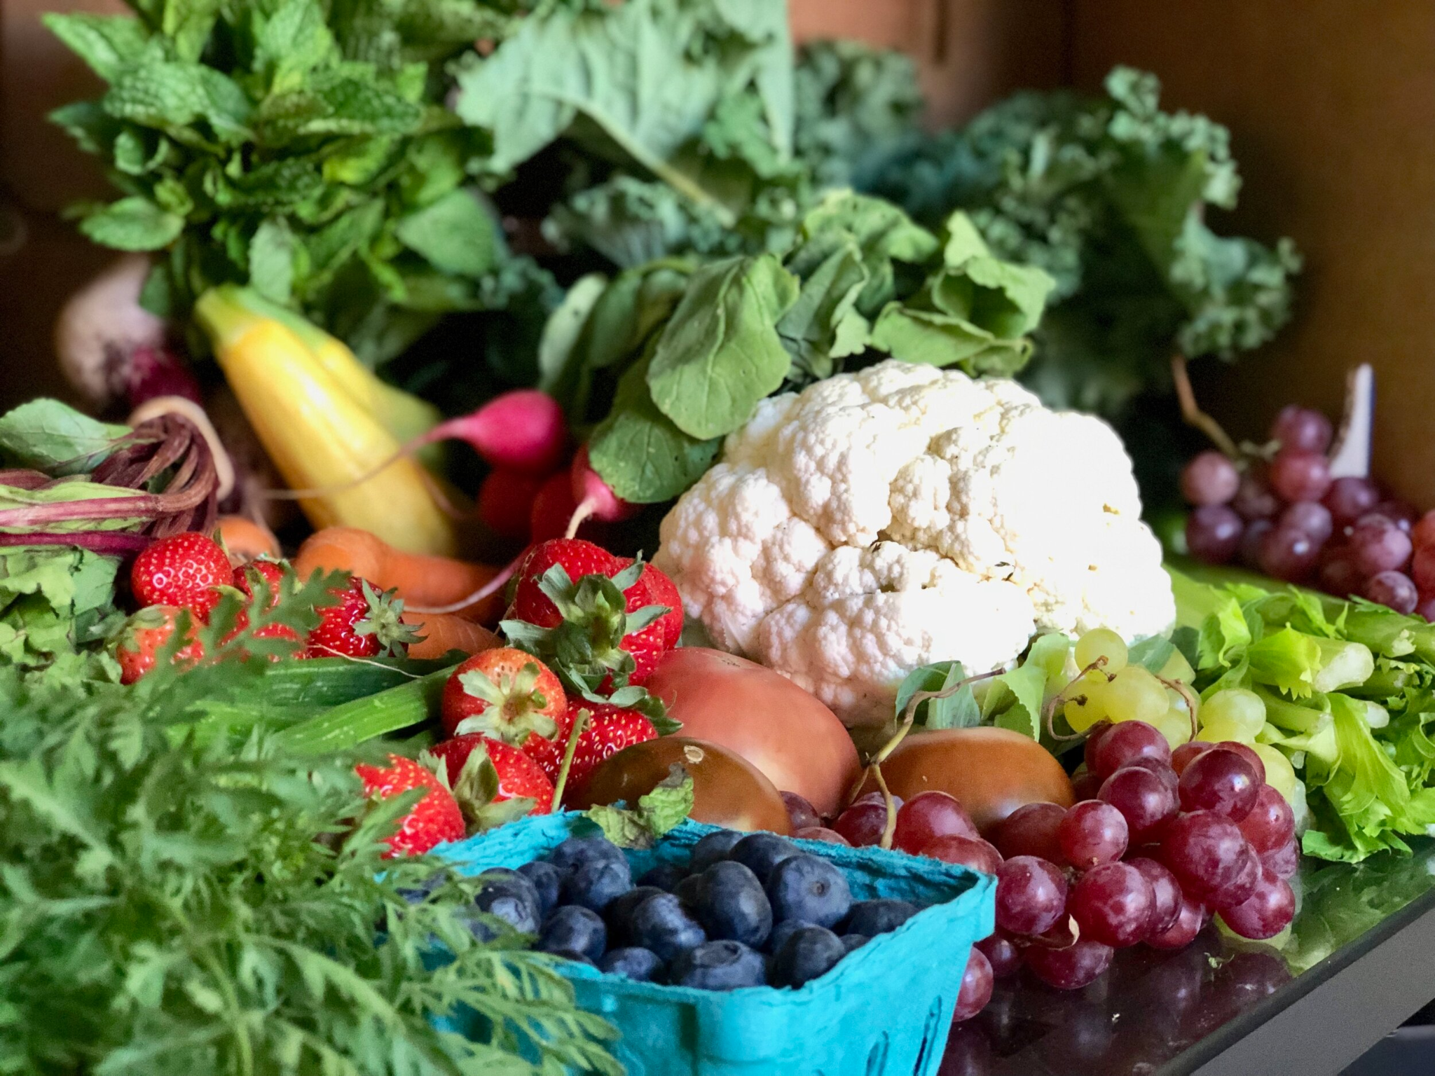
Discuss:
What do farmers need to grow healthy food?

Slide 10
Today, you’re going to think like climate-smart farmers — and design your own resilient farms.

Slide 11
Mapping Demo

Slide 12

Strawberries like well-drained soil and cool weather — where would you plant them?

Slide 13
03
Activity: Map the Future Farm

Slide 14
04
Environmental Risk

Slide 15
Would your farm survive a storm or dry season?

Slide 16
05
Disaster Strikes!

Slide 17
Where would you move and what would you change to protect your farm?

Slide 18
06
AI Demo - Teachable Machine

Slide 19
How To Be Involved
Wake County 4-H GIS Team
tbray@ncsu.edu
National 4-H Geospatial Team
contact@national4hgeospatialteam.us

Slide 20
Questions?

